Slide 1




Introduction to Bayesian inference and computation using INLA and inlabru
C. Edson Utazi
October 2026

Slide 2
Learning objectives
At the end of this session, you will be able to:
  Explain the underlying principles and key components of Bayesian inference and contrast these with frequentist inference
  Describe the principles of Bayesian computation and how INLA enables approximate Bayesian inference
  Apply basic INLA and inlabru syntax to implement and fit Bayesian statistical models and interpret the key outputs

Slide 3
Introduction to Bayesian inference
Statistical inference is the process of drawing conclusions about a population based on a finite sample drawn from that population
For example, suppose we want to estimate vaccination coverage in a population. We take a representative sample of 500 children and find that 72% have received the vaccine. Statistical inference allows us to use this sample information to estimate vaccination coverage in the wider population and to quantify the associated uncertainty. Under Bayesian inference, we might report the uncertainty that there is a 95% probability that the population coverage lies between 68% and 76%.

Slide 4
Introduction to Bayesian inference
Two approaches to statistical inference: Frequentist and Bayesian approaches
Aspect | Frequentist inference | Bayesian inference
View of parameters | Fixed, unknown constants - not random | Random variables with their own probability distribution
View of data | Random - one realization of a repeatable sampling process | Fixed, once observed - treated as given
Source of uncertainty | Sampling variability (what would happen over repeated samples) | Degree of belief about the parameter, updated by data
Basis for inference | Likelihood function, estimators (e.g. MLE) | Bayes' theorem: posterior ∝ likelihood × prior
Point estimate | Maximum likelihood estimate (MLE), method of moments | Posterior mean, median, or mode
Interval estimate | Confidence interval (CI) | Credible interval (CrI)

Slide 5
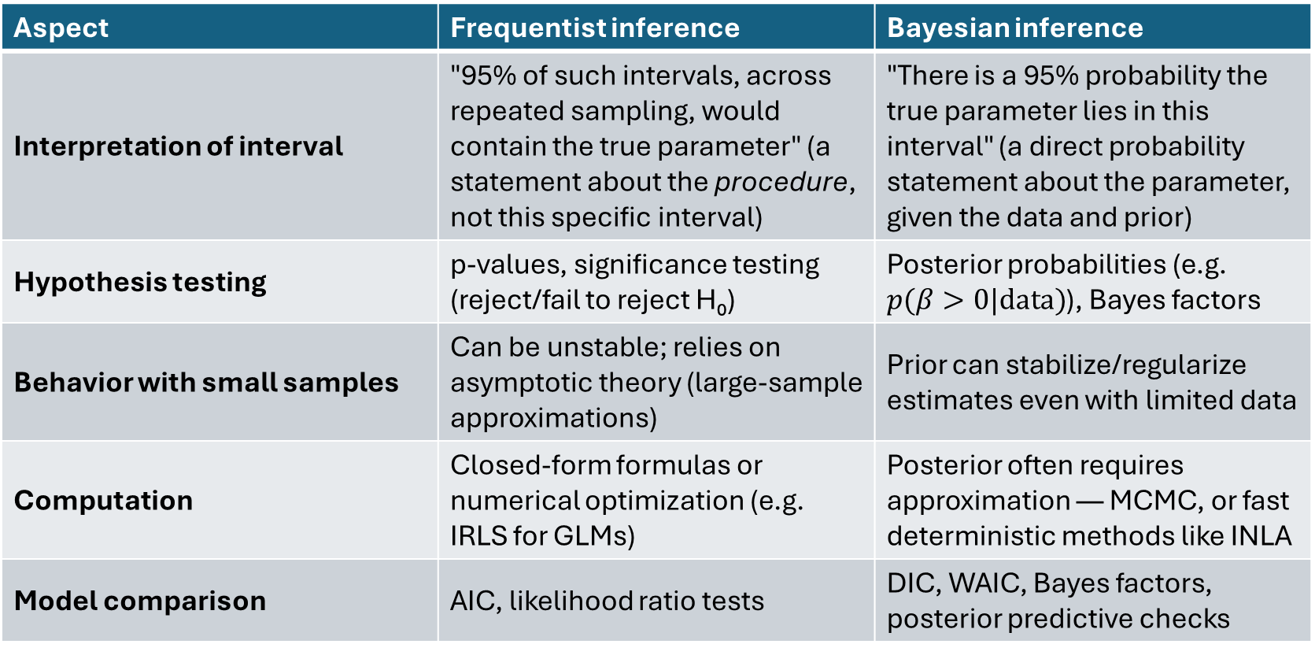
Introduction to Bayesian inference
Aspect | Frequentist inference | Bayesian inference
Interpretation of interval | "95% of such intervals, across repeated sampling, would contain the true parameter" (a statement about the procedure, not this specific interval) | "There is a 95% probability the true parameter lies in this interval" (a direct probability statement about the parameter, given the data and prior)
Hypothesis testing | p-values, significance testing (reject/fail to reject H₀) | Posterior probabilities (e.g. $p(β>0|data)$), Bayes factors
Behavior with small samples | Can be unstable; relies on asymptotic theory (large-sample approximations) | Prior can stabilize/regularize estimates even with limited data
Computation | Closed-form formulas or numerical optimization (e.g. IRLS for GLMs) | Posterior often requires approximation — MCMC, or fast deterministic methods like INLA
Model comparison | AIC, likelihood ratio tests | DIC, WAIC, Bayes factors, posterior predictive checks

Slide 6
Introduction to Bayesian inference
Bayesian interpretation feels more natural – consider how you interpret a 95% confidence interval vs a 95% credible interval
95% conf int: If we repeat the experiment a large number of times, then 95% of the time, the true value of the parameter will lie within the interval.
95% cred interval: There is a 95% probability that the true value of the parameter falls within the interval.
Really? Are we doing this?
This is what we would like to say!

Slide 7
Introduction to Bayesian inference
The basic philosophy underpinning Bayesian inference is the use of probability to measure uncertainty about unknown quantities, including parameters (In contrast, frequentist approach uses probability to describe the long run behaviour of data under repeated sampling)
In a Bayesian approach to a data analysis and modelling problem, the main task involves formulating and estimating probabilities of events or quantities of interest, using the observed data and any prior information relevant to the scientific enquiry
The integration of information from the observed data and prior information is facilitated by the application of the Bayes’ theorem

Slide 8
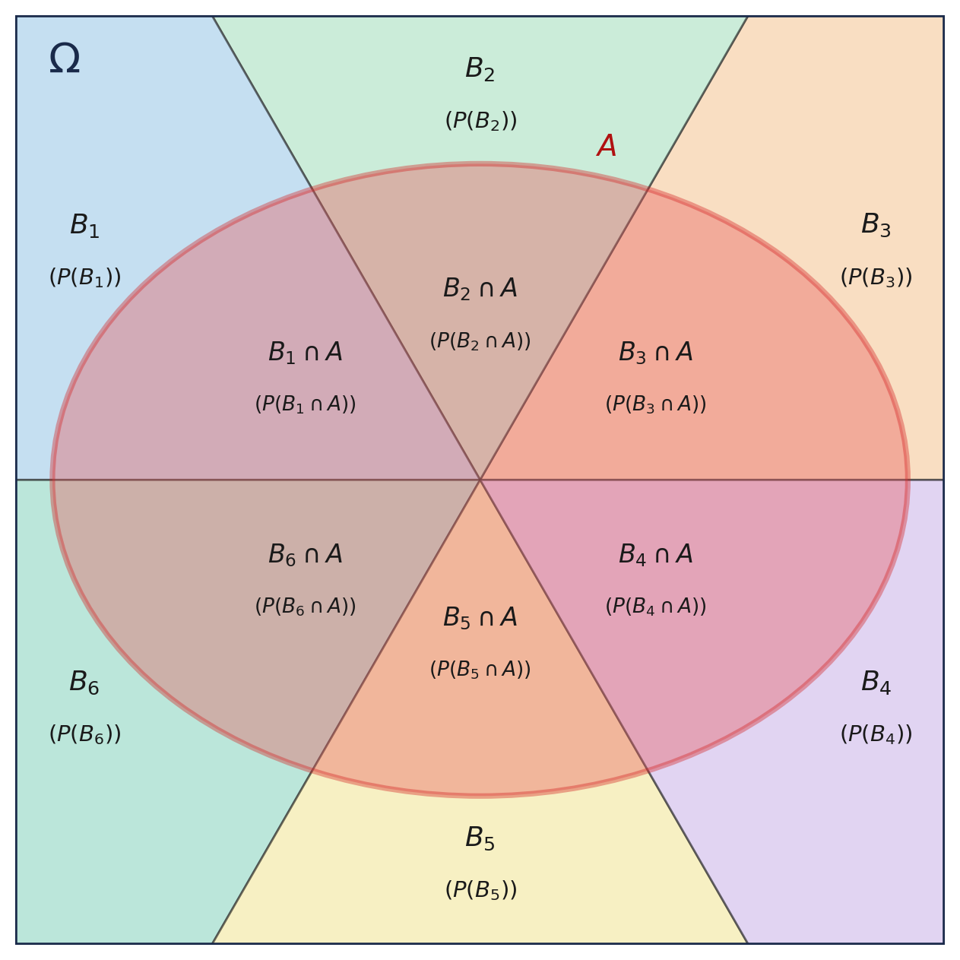
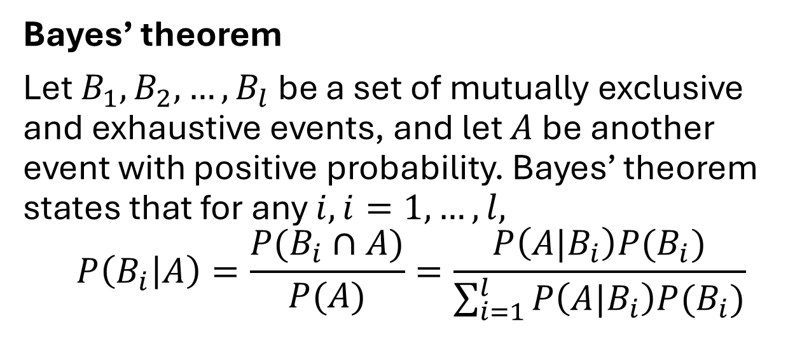
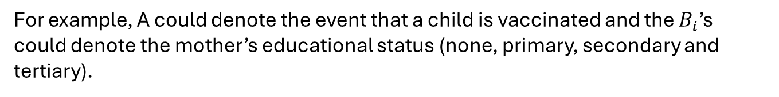
Bayes’ theorem
Bayes’ theorem
Let $B_{1},B_{2},…,B_{l}$ be a set of mutually exclusive and exhaustive events, and let $A$ be another event with positive probability. Bayes’ theorem states that for any $i, i=1,…,l,$
$$P\left(B_{i} | A\right)=\frac{P(B_{i}∩A)}{P(A)}=\frac{P\left(A|B_{i}\right)P(B_{i})}{\sum_{i=1}^{l}{P\left(A|B_{i}\right)P(B_{i})}}$$
For example, A could denote the event that a child is vaccinated and the $B_{i}$’s could denote the mother’s educational status (none, primary, secondary and tertiary).

Slide 9
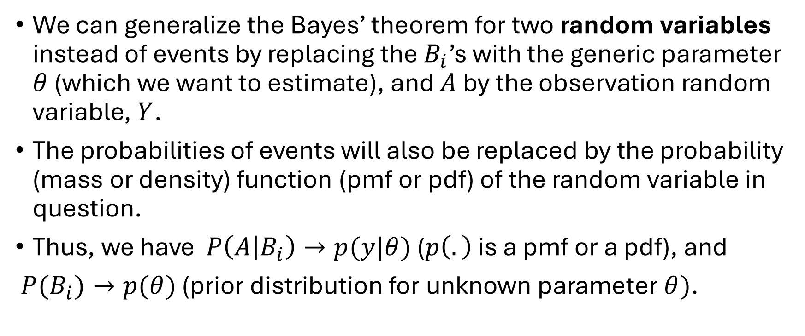
Bayes’ theorem
We can generalize the Bayes’ theorem for two random variables instead of events by replacing the $B_{i}$’s with the generic parameter $θ$ (which we want to estimate), and $A$ by the observation random variable, $Y$.
The probabilities of events will also be replaced by the probability (mass or density) function (pmf or pdf) of the random variable in question.
Thus, we have $P\left(A | B_{i}\right)→p(y|θ)$ ($p\left(.\right)$ is a pmf or a pdf), and
$P(B_{i})→p(θ)$ (prior distribution for unknown parameter $θ)$.

Slide 10
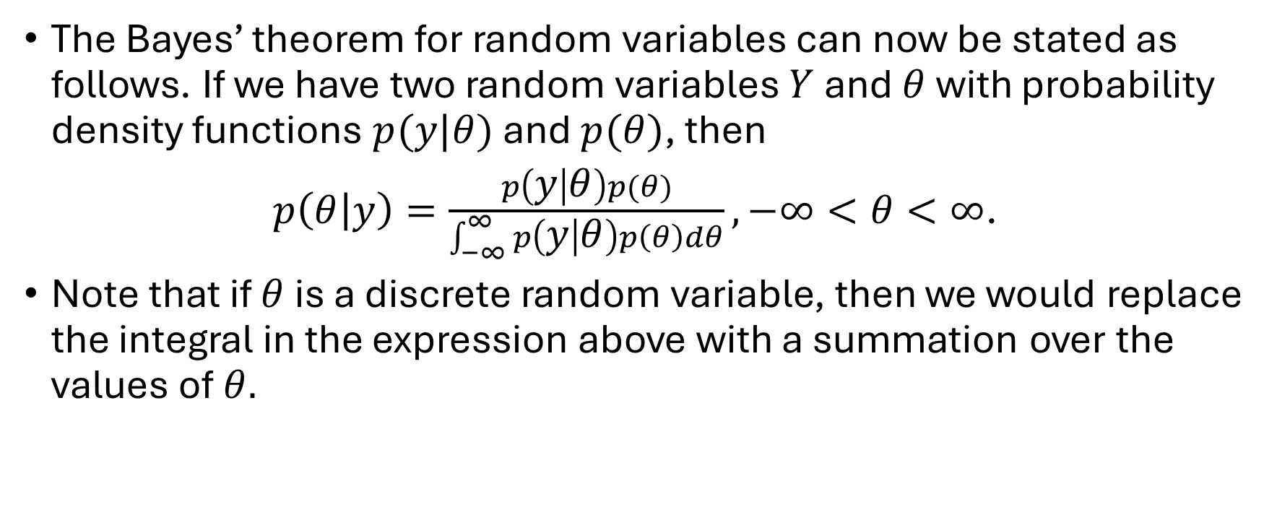
Bayes’ theorem – the posterior distribution
The Bayes’ theorem for random variables can now be stated as follows. If we have two random variables $Y$ and $θ$ with probability density functions $p(y|θ)$ and $p(θ)$, then
$p\left(θ | y\right)=\frac{p\left(y | θ\right)p(θ)}{\int_{−∞}^{∞}{p\left(y | θ\right)p\left(θ\right)dθ}}, −∞<θ<∞$.
Note that if $θ$ is a discrete random variable, then we would replace the integral in the expression above with a summation over the values of $θ.$
Prior distribution
Likelihood
Posterior distribution

Slide 11
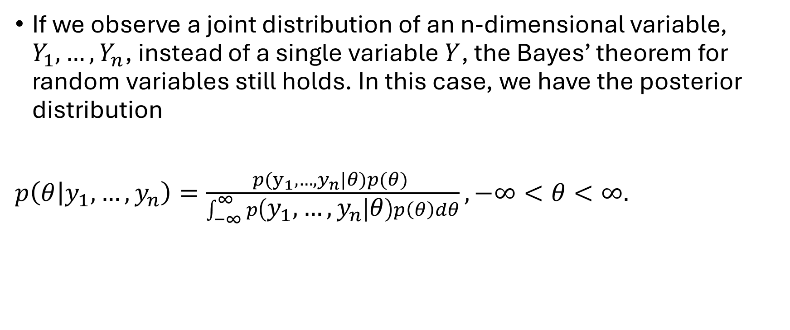
Bayes’ theorem – the posterior distribution
If we observe a joint distribution of an n-dimensional variable, $Y_{1},…,Y_{n}$, instead of a single variable $Y$, the Bayes’ theorem for random variables still holds. In this case, we have the posterior distribution
$p\left(θ | y_{1},…,y_{n}\right)=\frac{p(y_{1},…,y_{n}|θ)p(θ) }{\int_{−∞}^{∞}{p\left(y_{1},…,y_{n} | θ\right)p\left(θ\right)dθ}},−∞<θ<∞.$

Slide 12
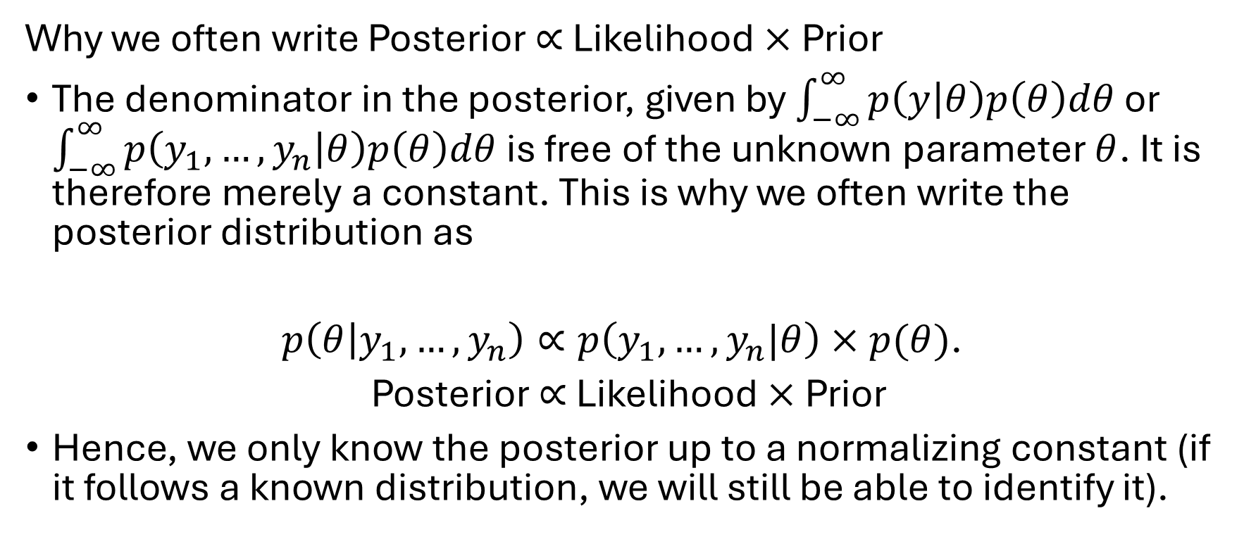
Bayes’ theorem – the posterior distribution
Why we often write Posterior $∝$ Likelihood $×$ Prior
The denominator in the posterior, given by $\int_{−∞}^{∞}{p\left(y | θ\right)p\left(θ\right)dθ}$ or $\int_{−∞}^{∞}{p\left(y_{1},…,y_{n} | θ\right)p\left(θ\right)dθ}$ is free of the unknown parameter $θ$. It is therefore merely a constant. This is why we often write the posterior distribution as
$p\left(θ | y_{1},…,y_{n}\right)∝p\left(y_{1},…,y_{n}|θ\right)×p(θ)$.
Posterior $∝$ Likelihood $×$ Prior
Hence, we only know the posterior up to a normalizing constant (if it follows a known distribution, we will still be able to identify it).

Slide 13
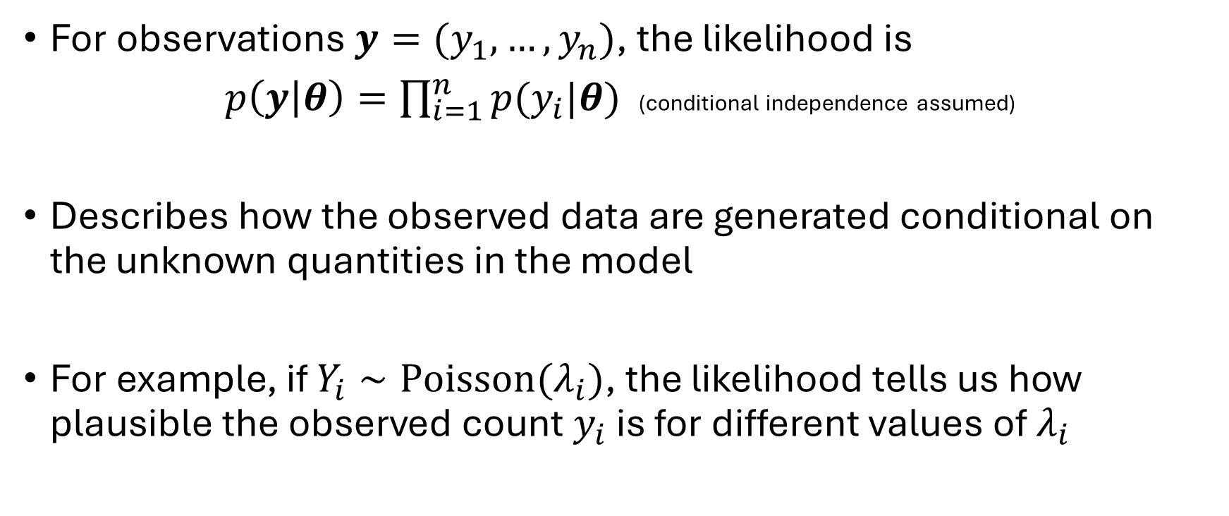
The likelihood – How do we model the data?
For observations $y=(y_{1},…,y_{n})$, the likelihood is
$p\left(y | θ\right)=\prod_{i=1}^{n}{p(y_{i}|θ)}$ (conditional independence assumed)
Describes how the observed data are generated conditional on the unknown quantities in the model
For example, if $Y_{i}∼Poisson(λ_{i})$, the likelihood tells us how plausible the observed count $y_{i}$ is for different values of $λ_{i}$

Slide 14
Choosing a likelihood
Choosing a likelihood – The choice of a likelihood should primarily be driven by the nature of the outcome and the data-generating mechanism
Outcome | Possible likelihood
Continuous approximately Gaussian | Normal
Binary | Bernoulli
Proportion / number successes | Binomial
Counts | Poisson
Overdispersed counts | Negative binomial
Excess zeros | Zero-inflated / hurdle models
Time-to-event | Survival likelihoods
Spatially continuous measurements | Gaussian
Example likelihoods

Slide 15
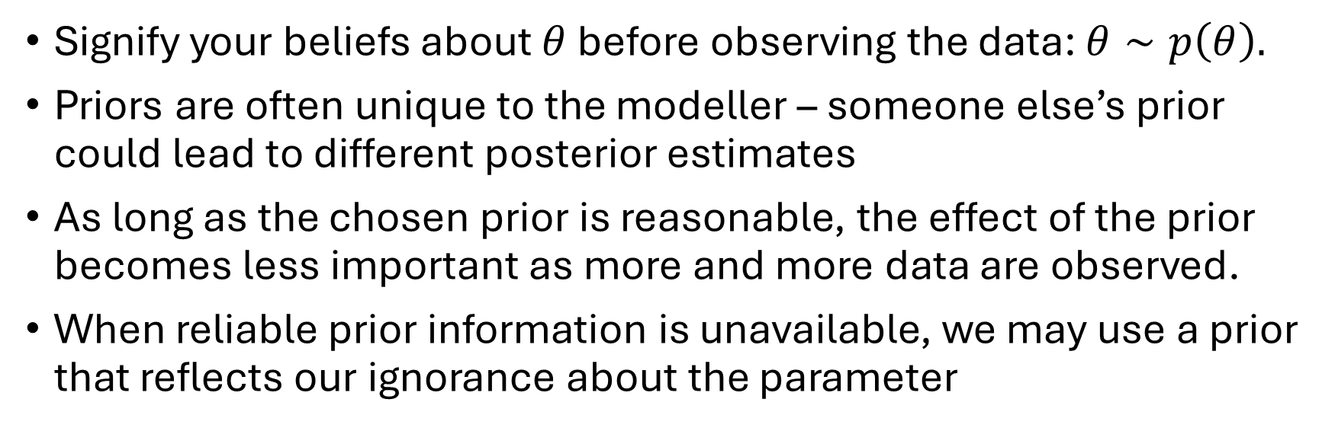
Prior distributions
Signify your beliefs about $θ$ before observing the data: $θ∼p\left(θ\right).$
Priors are often unique to the modeller – someone else’s prior could lead to different posterior estimates
As long as the chosen prior is reasonable, the effect of the prior becomes less important as more and more data are observed.
When reliable prior information is unavailable, we may use a prior that reflects our ignorance about the parameter

Slide 16
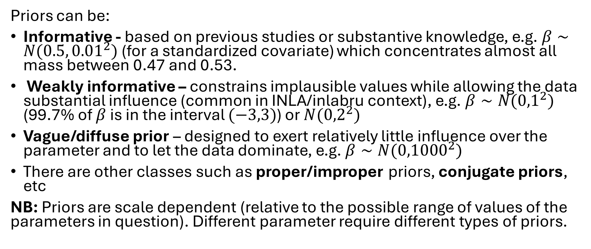
Prior distributions
Priors can be:
Informative - based on previous studies or substantive knowledge, e.g. $β∼N(0.5, {0.01}^{2})$ (for a standardized covariate) which concentrates almost all mass between 0.47 and 0.53.
Weakly informative – constrains implausible values while allowing the data substantial influence (common in INLA/inlabru context), e.g. $β∼N({0,1}^{2})$ (99.7% of $β$ is in the interval $(−3,3)$) or $N({0,2}^{2})$
Vague/diffuse prior – designed to exert relatively little influence over the parameter and to let the data dominate, e.g. $β∼N({0,1000}^{2})$
There are other classes such as proper/improper priors, conjugate priors, etc
NB: Priors are scale dependent (relative to the possible range of values of the parameters in question). Different parameter require different types of priors.

Slide 17
Prior distributions
Likelihood | Conjugate priors
Normal | Normal
Binomial | Beta
Poisson | Gamma
Exponential | Gamma
Negative binomial | Beta
For conjugate priors, the posterior distribution belongs to the same parametric family as the prior distribution
Conjugacy is a desirable attribute when solving Bayesian analytically.

Slide 18
Penalized complexity (PC) priors
Introduced by Simpson et al (2017)*, PC priors provide a principled way to construct informative, flexible priors by shrinking a complex model toward a simpler, base model.
PC priors
  define a base model representing the simplest plausible model.
  measure the complexity of a more flexible model using a distance (Kullback-Leibler distance) from the base model.
  assign a prior that penalizes increasing complexity, while allowing the data to support departure from the base model.
  the prior is typically calibrated through an interpretable probability statement.
* Daniel Simpson, Håvard Rue, Andrea Riebler, Thiago G. Martins, Sigrunn H. Sørbye (2017). Penalising Model Component Complexity: A Principled, Practical Approach to Constructing Priors, Statist. Sci. 32(1), 1-28.

Slide 19
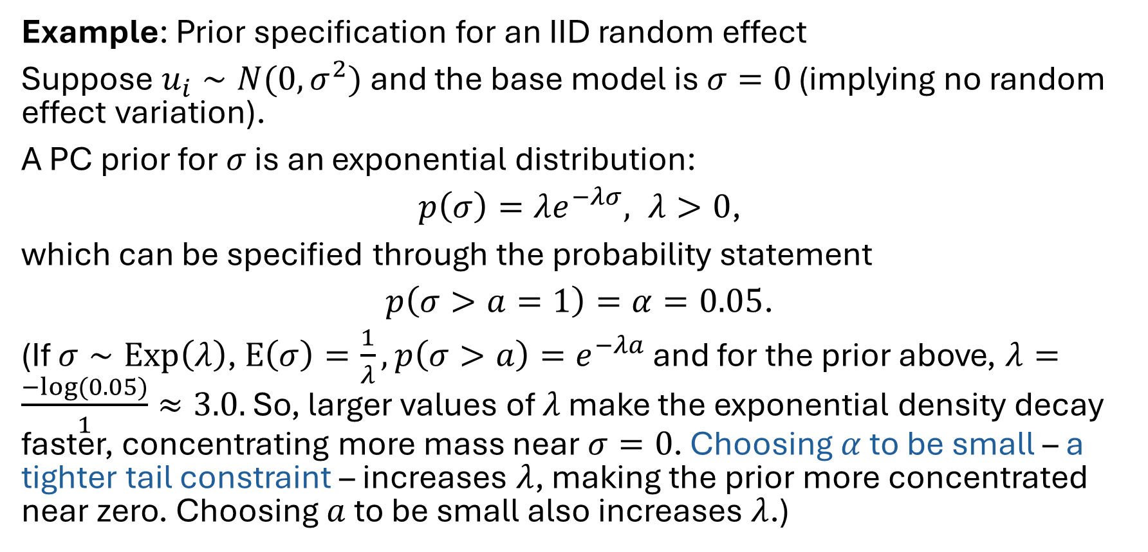
Penalized complexity (PC) priors
Example: Prior specification for an IID random effect
Suppose $u_{i}∼N(0,σ^{2})$ and the base model is $σ=0$ (implying no random effect variation).
A PC prior for $σ$ is an exponential distribution:
$p\left(σ\right)=λe^{−λσ}, λ>0$,
which can be specified through the probability statement
$p\left(σ>a=1\right)=α=0.05$.
(If $σ∼Exp\left(λ\right)$, $E\left(σ\right)=\frac{1}{λ}, p\left(σ>a\right)=e^{−λa}$ and for the prior above, $λ=\frac{−log⁡(0.05)}{1}≈3.0.$ So, larger values of $λ$ make the exponential density decay faster, concentrating more mass near $σ=0$. Choosing $α$ to be small – a tighter tail constraint – increases $λ$, making the prior more concentrated near zero. Choosing $a$ to be small also increases $λ$.)

Slide 20
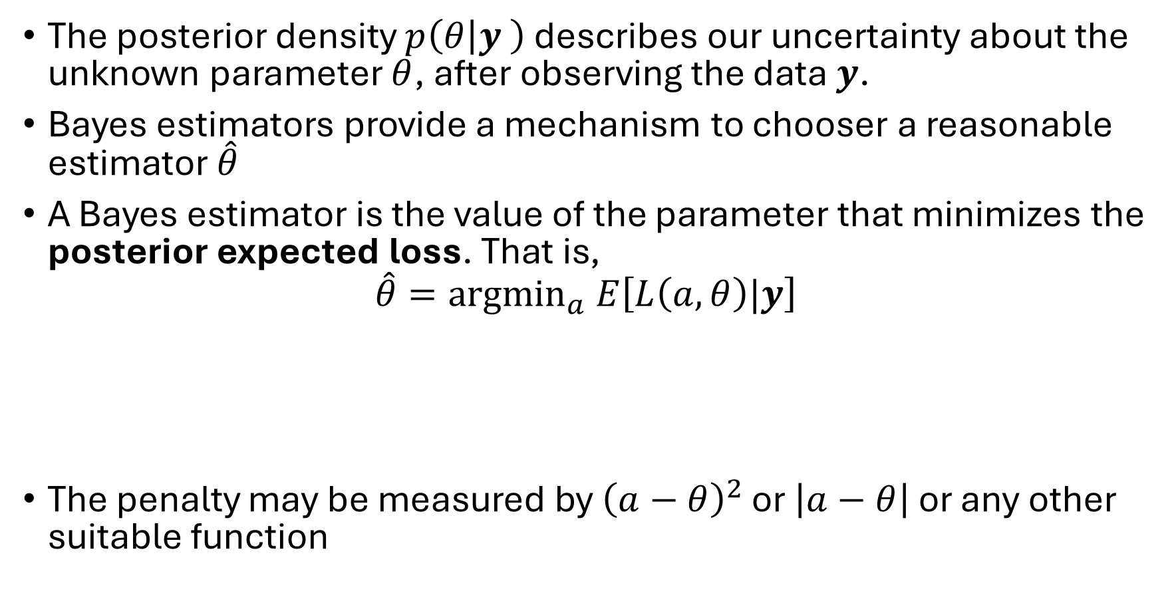
Bayesian estimators
The posterior density $p\left(θ | y \right)$ describes our uncertainty about the unknown parameter $θ$, after observing the data $y$.
Bayes estimators provide a mechanism to chooser a reasonable estimator $\hat{θ}$
A Bayes estimator is the value of the parameter that minimizes the posterior expected loss. That is,
$$\hat{θ}={argmin}_{a} E\left[L\left(a,θ\right)|y\right]$$
The penalty may be measured by ${\left(a−θ\right)}^{2}$ or $\left|a−θ\right|$ or any other suitable function
Our estimate of the true unknown parameter
Penalty we pay for estimating incorrectly

Slide 21
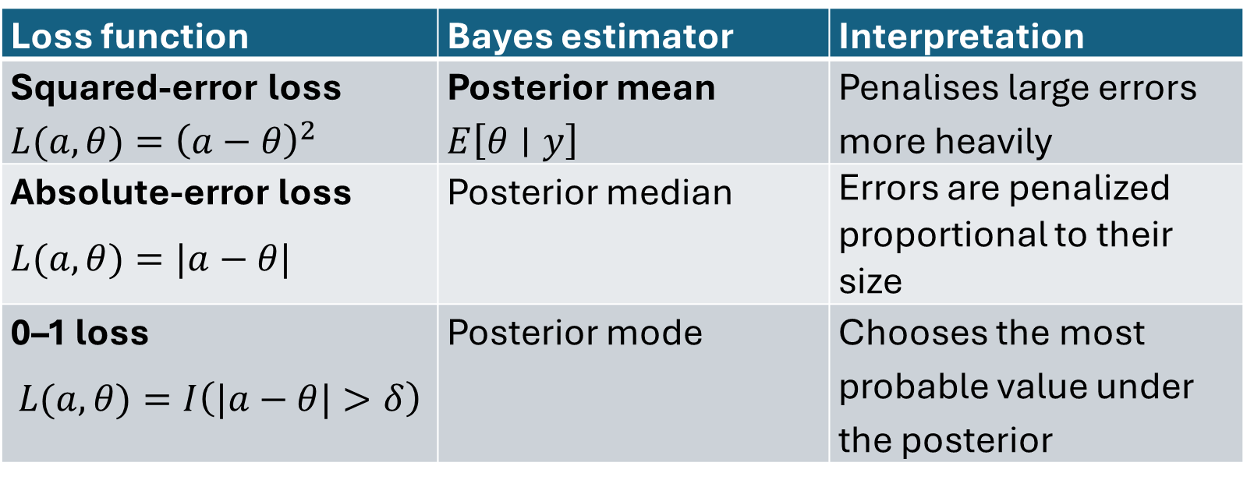
Bayesian estimators
Loss function | Bayes estimator | Interpretation
Squared-error loss $L(a,θ)={\left(a−θ\right)}^{2}$ | Posterior mean $E\left[θ∣y\right]$ | Penalises large errors more heavily
Absolute-error loss $L(a,θ)=|a−θ|$ | Posterior median | Errors are penalized proportional to their size
0–1 loss $$L(a,θ)=I\left(|a−θ|>δ\right)$$ | Posterior mode | Chooses the most probable value under the posterior
For a skewed posterior, the mean and median can differ substantially.
The median is particularly useful when you want a point estimate that is relatively robust to extreme values in the posterior.

Slide 22

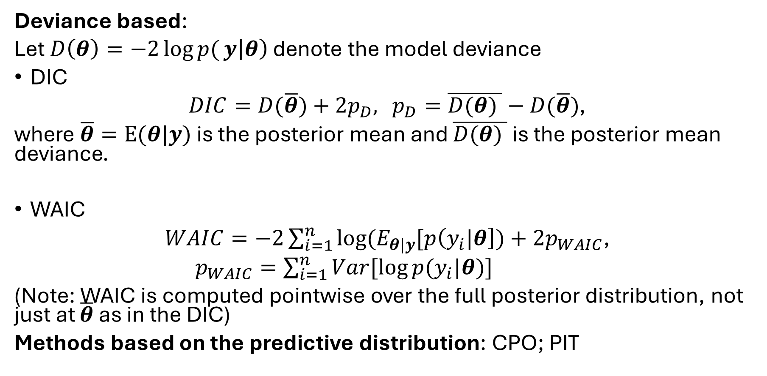
Bayesian model choice
Deviance based:
Let $D\left(θ\right)=−2\log{p(}y\left|θ\right)$ denote the model deviance
DIC
$DIC=D(\overline{θ})+2p_{D},$ $p_{D}=\overline{D(θ) }−D(\overline{θ})$,
where $\overline{θ}=E(θ|y)$ is the posterior mean and $\overline{D(θ) }$ is the posterior mean deviance.
WAIC
$WAIC=−2\sum_{i=1}^{n}{log⁡(E_{θ|y}[p\left(y_{i}|θ\right])}+2p_{WAIC}$,
$p_{WAIC}=\sum_{i=1}^{n}{Var[\log{p(y_{i}|θ)}]}$
(Note: WAIC is computed pointwise over the full posterior distribution, not just at $\overline{θ}$ as in the DIC)
Methods based on the predictive distribution: CPO; PIT
$$D_{WAIC}$$

Slide 23
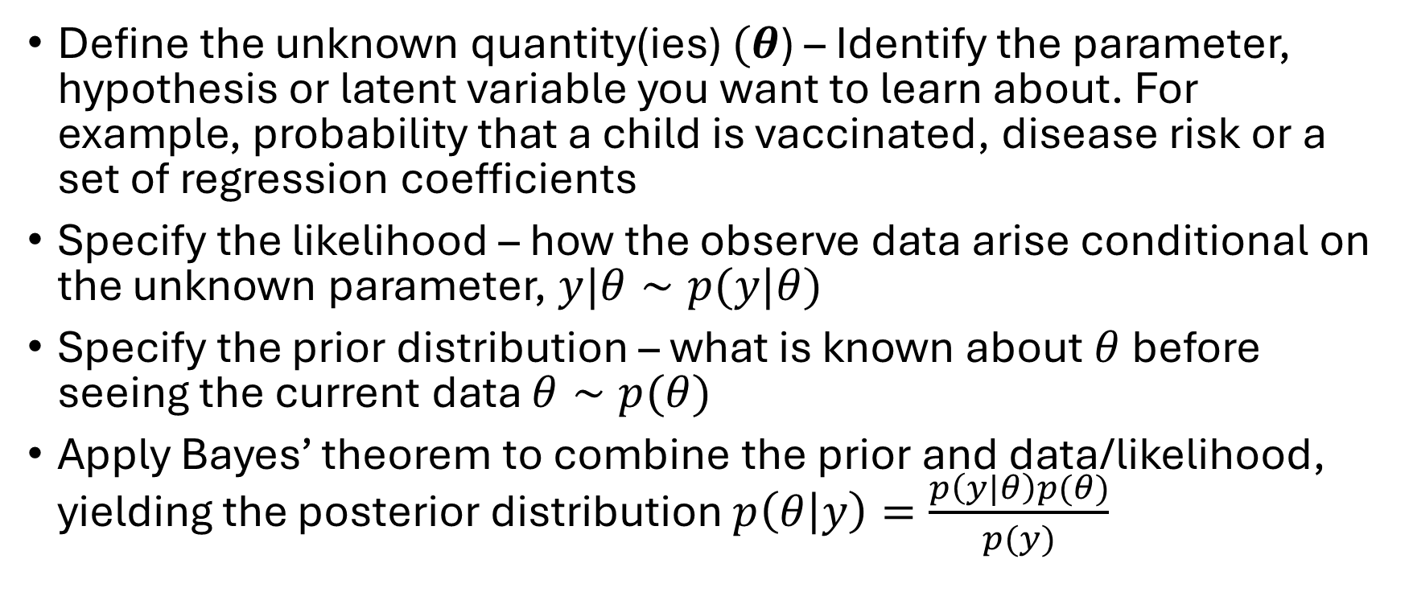
Key ingredients of Bayesian inference
Define the unknown quantity(ies) $(θ$) – Identify the parameter, hypothesis or latent variable you want to learn about. For example, probability that a child is vaccinated, disease risk or a set of regression coefficients
Specify the likelihood – how the observe data arise conditional on the unknown parameter, $y|θ∼p(y|θ)$
Specify the prior distribution – what is known about $θ$ before seeing the current data $θ∼p(θ)$
Apply Bayes’ theorem to combine the prior and data/likelihood, yielding the posterior distribution $p\left(θ | y\right)=\frac{p\left(y|θ\right)p(θ)}{p(y)}$

Slide 24
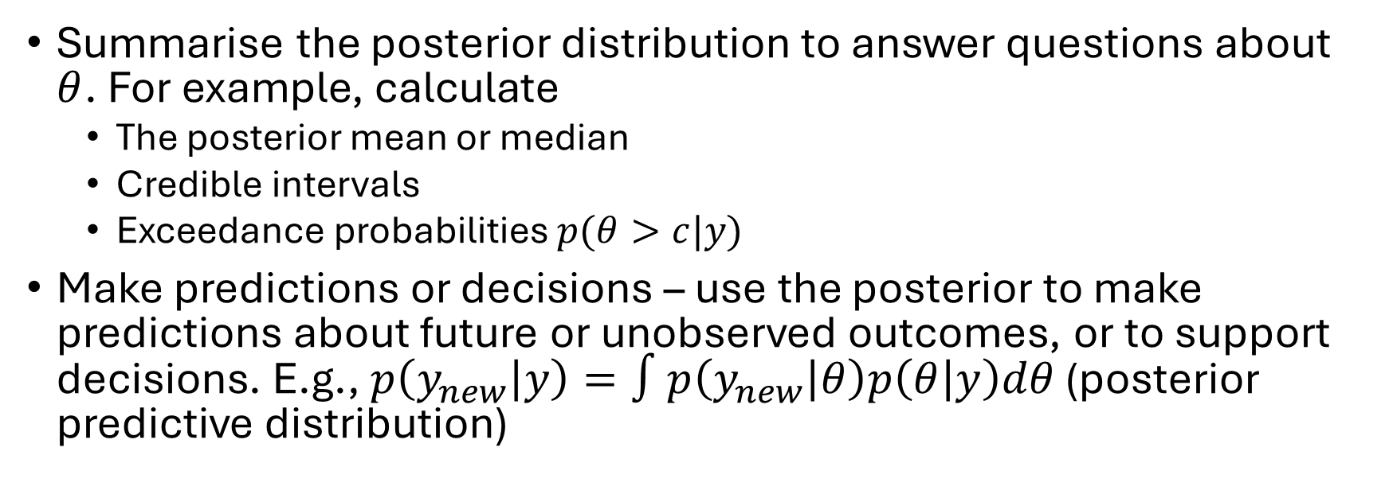
Key ingredients of Bayesian inference
Summarise the posterior distribution to answer questions about $θ$. For example, calculate
  The posterior mean or median
  Credible intervals
  Exceedance probabilities $p(θ>c|y)$
Make predictions or decisions – use the posterior to make predictions about future or unobserved outcomes, or to support decisions. E.g., $p\left(y_{new} | y\right)=∫p\left(y_{new} | θ\right)p\left(θ | y\right)dθ$ (posterior predictive distribution)
1. Unknowns → 2. Prior → 3. Likelihood → 4. Bayes' theorem → 5. Posterior inference → 6. Prediction & decisions

Slide 25
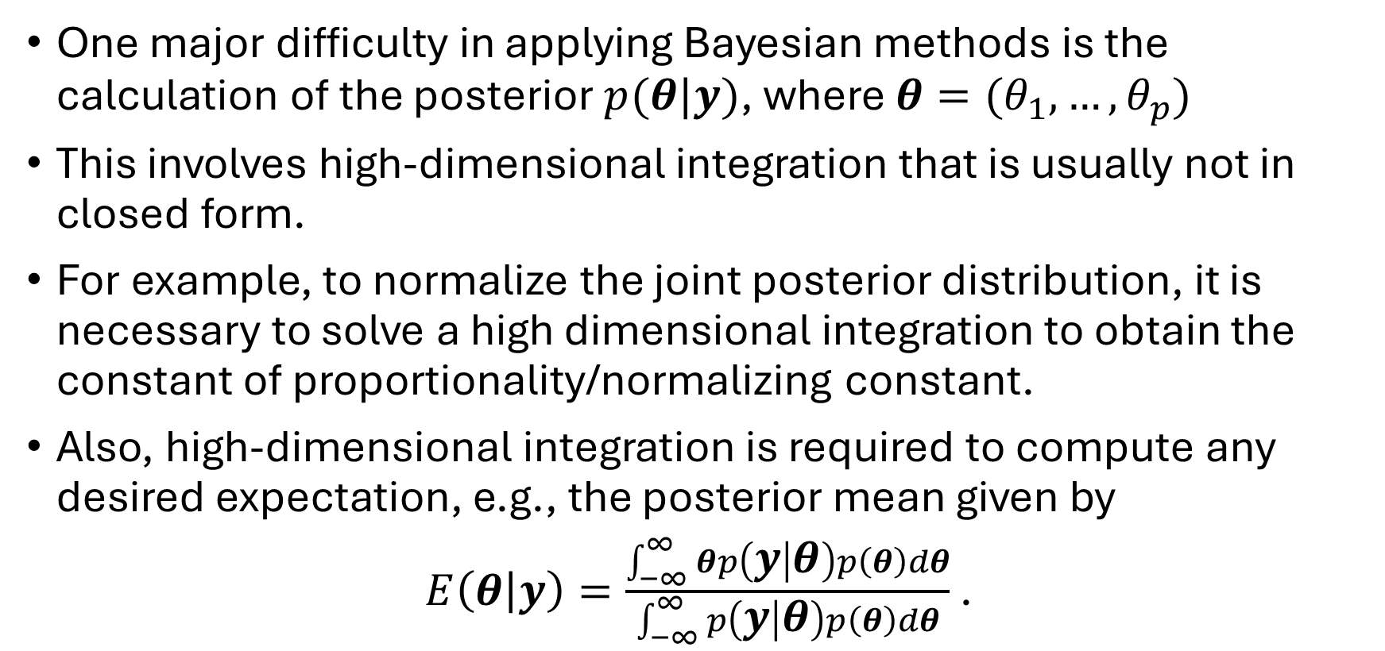
Bayesian computation
Set of observations
One major difficulty in applying Bayesian methods is the calculation of the posterior $p(θ|y)$, where $θ=(θ_{1},…,θ_{p})$
This involves high-dimensional integration that is usually not in closed form.
For example, to normalize the joint posterior distribution, it is necessary to solve a high dimensional integration to obtain the constant of proportionality/normalizing constant.
Also, high-dimensional integration is required to compute any desired expectation, e.g., the posterior mean given by
$E\left(θ | y\right)=\frac{\int_{−∞}^{∞}{θp\left(y | θ\right)p\left(θ\right)dθ}}{\int_{−∞}^{∞}{p\left(y | θ\right)p\left(θ\right)dθ}}$ .

Slide 26
Bayesian computation
Modern Bayesian computation consider the integration problem as another statistical problem
The posterior distribution is viewed as a population distribution whose characteristics are unknown to us (reminiscent of the statistical problem of making inference about an unknown population)
The statistical solution to the problem is to draw samples from the unknown population and then make inference about its characteristics (mean, variance, etc) by calculating suitable statistical averages of the sampled values.

Slide 27
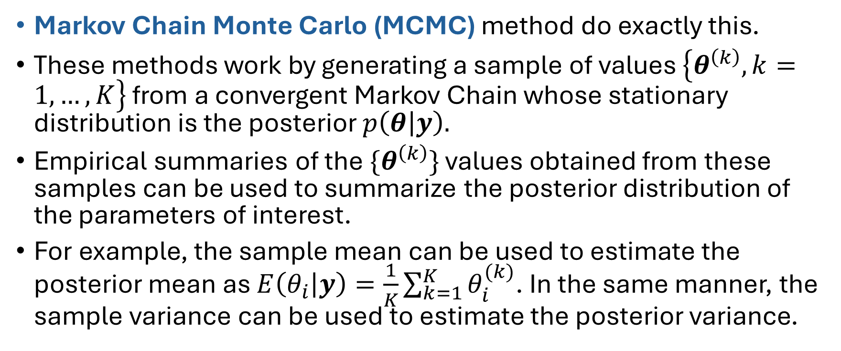
Bayesian computation
Markov Chain Monte Carlo (MCMC) method do exactly this.
These methods work by generating a sample of values $\left\{θ^{\left(k\right)}, k=1,…,K\right\}$ from a convergent Markov Chain whose stationary distribution is the posterior $p\left(θ | y\right).$
Empirical summaries of the${ \{θ}^{\left(k\right)}\}$ values obtained from these samples can be used to summarize the posterior distribution of the parameters of interest.
For example, the sample mean can be used to estimate the posterior mean as $E\left(θ_{i} | y\right)=\frac{1}{K}\sum_{k=1}^{K}{θ_{i}^{(k)}}$. In the same manner, the sample variance can be used to estimate the posterior variance.

Slide 28
Bayesian computation
MCMC methods require diagnostic approaches to determine when the sampling chains have reached the stationary distribution, i.e., the posterior distribution.
Such diagnostic approaches include the use of traceplots, sample autocorrelations, Geweke diagnostic, running parallel chains with different initial values, etc
MCMC approaches are however sampling-based methods that are computationally demanding and often experience convergence problems.

Slide 29
INLA – Integrated Nested Laplace Approximation
INLA is a deterministic method for performing approximate Bayesian inference in latent Gaussian models
INLA is a faster alternative to the traditional stochastic sampling methods like MCMC, as it uses analytical approximations and numerical integration to compute marginal posterior distributions directly
INLA is implemented in the R packages R-INLA (http://www.r-inla.org) and inlabru (http://www.inlabru.org)

Slide 30
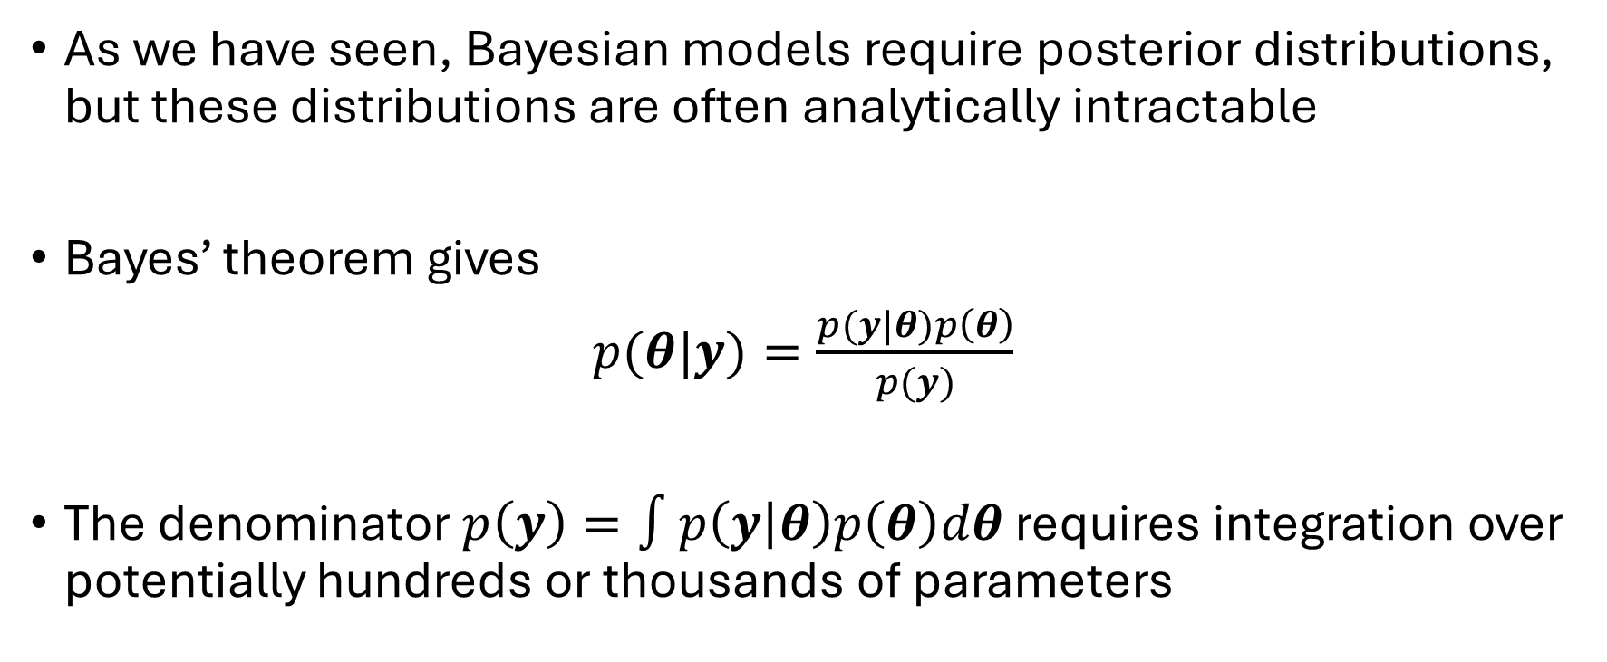
INLA – Integrated Nested Laplace Approximation
As we have seen, Bayesian models require posterior distributions, but these distributions are often analytically intractable
Bayes’ theorem gives
$p(θ|y)=\frac{p(y|θ)p\left(θ\right)}{p(y)}$
The denominator $p\left(y\right)=∫p\left(y | θ\right)p\left(θ\right)dθ$ requires integration over potentially hundreds or thousands of parameters

Slide 31
INLA – Integrated Nested Laplace Approximation
INLA tries to approximate the required integrals deterministically, primarily using Laplace approximations.
INLA exploits a special structure of the model: the latent field is Gaussian

Slide 32
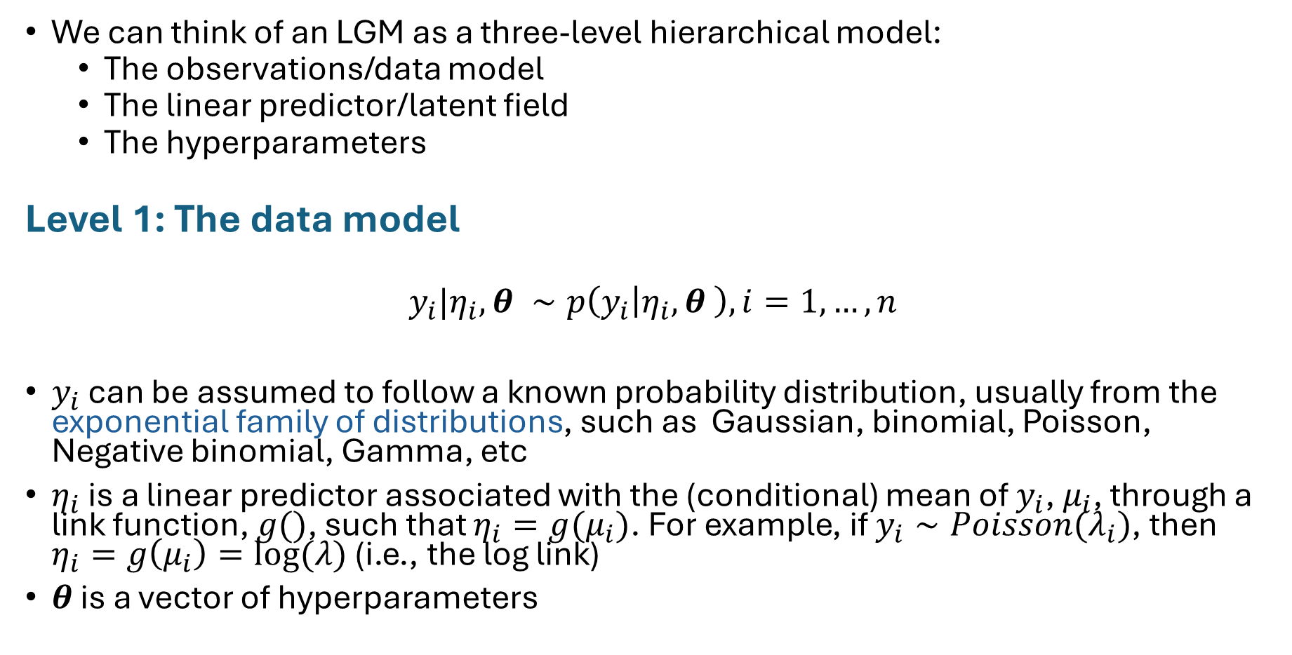
Latent Gaussian models (LGMs)
We can think of an LGM as a three-level hierarchical model:
  The observations/data model
  The linear predictor/latent field
  The hyperparameters
Level 1: The data model
$$y_{i}|η_{i},θ ∼p\left(y_{i} | η_{i},θ \right), i=1,…,n$$
$y_{i}$ can be assumed to follow a known probability distribution, usually from the exponential family of distributions, such as Gaussian, binomial, Poisson, Negative binomial, Gamma, etc
$η_{i}$ is a linear predictor associated with the (conditional) mean of $y_{i}$, $μ_{i}$, through a link function, $g()$, such that $η_{i}=g(μ_{i})$. For example, if $y_{i}∼Poisson(λ_{i})$, then $η_{i}=g\left(μ_{i}\right)=log⁡(λ)$ (i.e., the log link)
$θ$ is a vector of hyperparameters

Slide 33
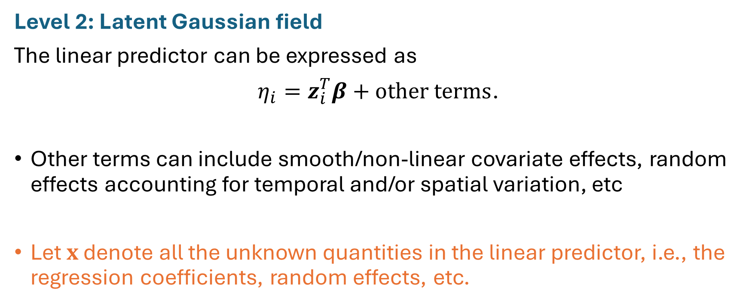
Latent Gaussian models (LGMs)
Level 2: Latent Gaussian field
The linear predictor can be expressed as
$η_{i}=z_{i}^{T}β+other terms$.
Other terms can include smooth/non-linear covariate effects, random effects accounting for temporal and/or spatial variation, etc
Let $x$ denote all the unknown quantities in the linear predictor, i.e., the regression coefficients, random effects, etc.
covariate vector

Slide 34
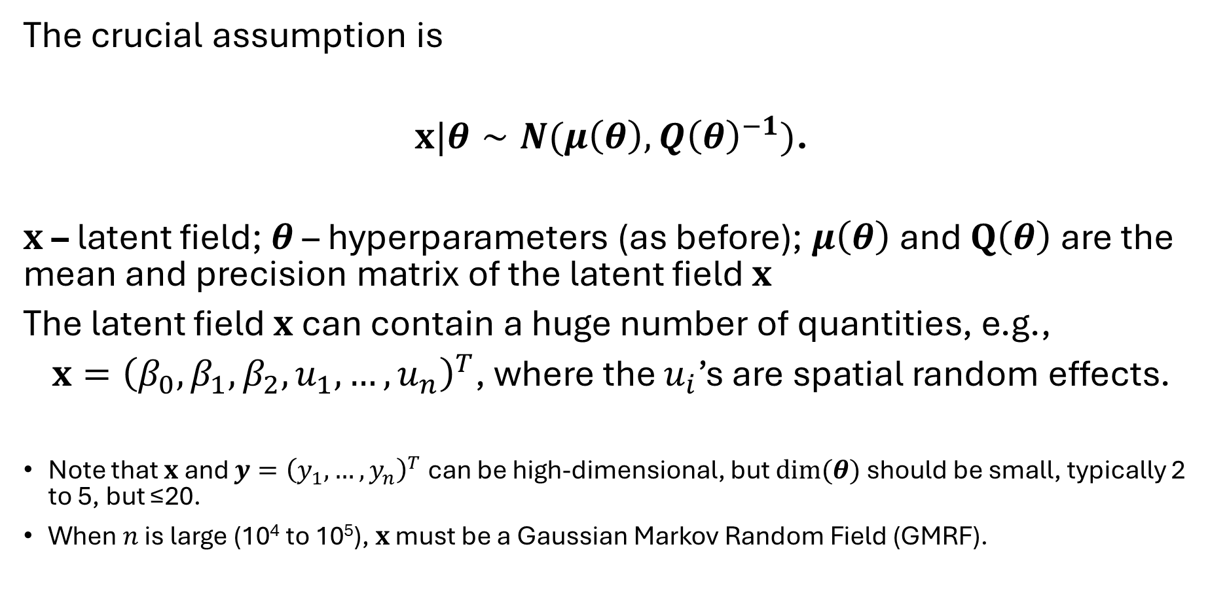
Latent Gaussian models (LGMs)
The crucial assumption is
$x|θ∼N(μ\left(θ\right),Q{\left(θ\right)}^{−1})$.
$x$ – latent field; $θ$ – hyperparameters (as before); $μ\left(θ\right)$ and $Q\left(θ\right)$ are the mean and precision matrix of the latent field $x$
The latent field $x$ can contain a huge number of quantities, e.g.,
$x={\left(β_{0},β_{1},β_{2},u_{1},…,u_{n}\right)}^{T}$, where the $u_{i}$’s are spatial random effects.
Note that $x$ and $y={\left(y_{1},…,y_{n}\right)}^{T}$ can be high-dimensional, but $dim⁡(θ)$ should be small, typically 2 to 5, but ≤20.
When $n$ is large (10⁴ to 10⁵), $x$ must be a Gaussian Markov Random Field (GMRF).
Gaussian part of “latent Gaussian model”

Slide 35
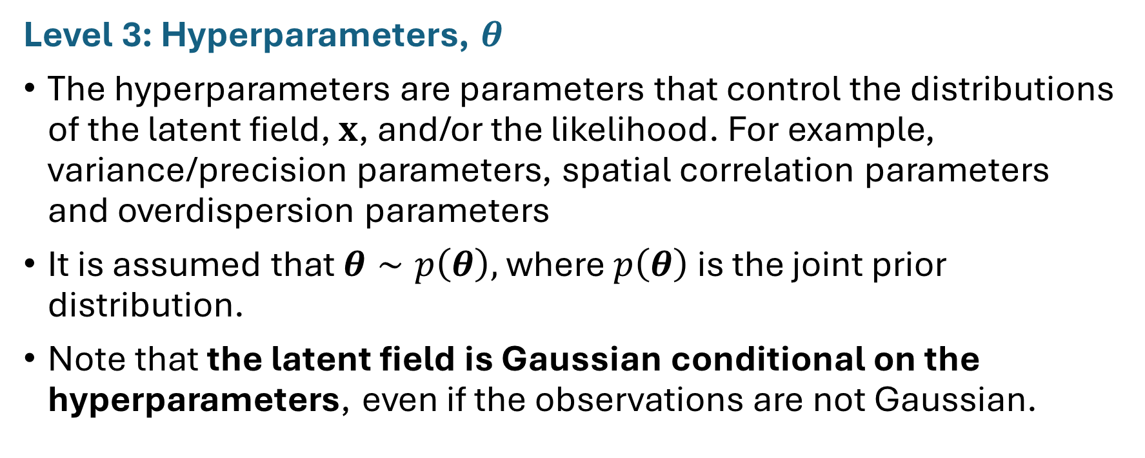
Latent Gaussian models (LGMs)
Level 3: Hyperparameters, $θ$
The hyperparameters are parameters that control the distributions of the latent field, $x$, and/or the likelihood. For example, variance/precision parameters, spatial correlation parameters and overdispersion parameters
It is assumed that $θ∼p\left(θ\right),$ where $p\left(θ\right)$ is the joint prior distribution.
Note that the latent field is Gaussian conditional on the hyperparameters, even if the observations are not Gaussian.

Slide 36
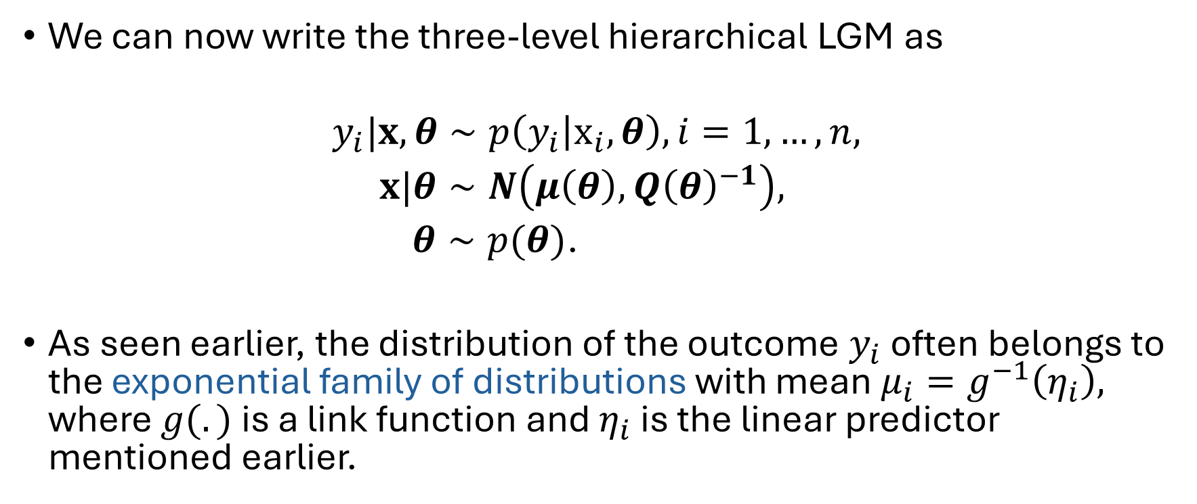
Latent Gaussian models (LGMs)
We can now write the three-level hierarchical LGM as
$$y_{i}|x,θ∼p\left(y_{i} | x_{i},θ\right), i=1,…,n,$$
$x|θ∼N\left(μ\left(θ\right),Q{\left(θ\right)}^{−1}\right),$
$θ∼p(θ)$.
As seen earlier, the distribution of the outcome $y_{i}$ often belongs to the exponential family of distributions with mean $μ_{i}=g^{−1}\left(η_{i}\right),$ where $g(.)$ is a link function and $η_{i}$ is the linear predictor mentioned earlier.

Slide 37
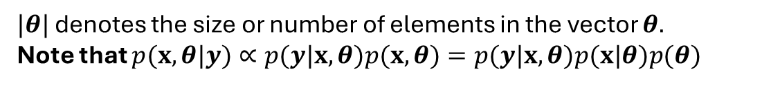
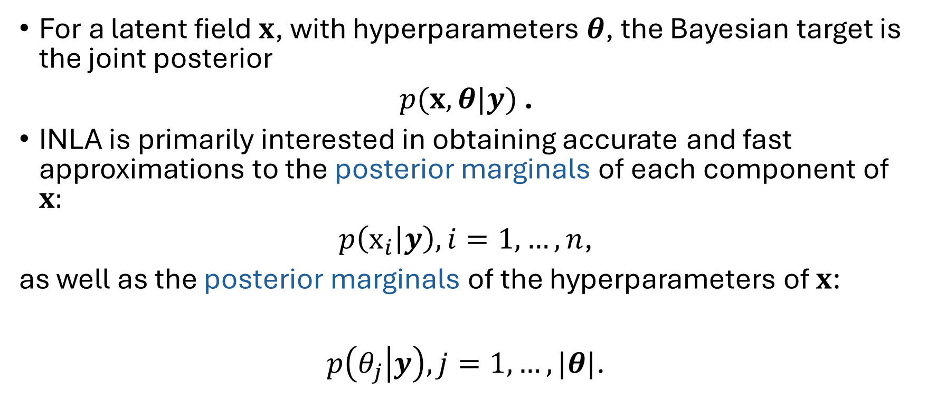
What does INLA actually calculate?
For a latent field $x$, with hyperparameters $θ$, the Bayesian target is the joint posterior
$p(x,θ|y)$ .
INLA is primarily interested in obtaining accurate and fast approximations to the posterior marginals of each component of $x:$
$p\left(x_{i} | y\right), i=1,…,n$,
as well as the posterior marginals of the hyperparameters of $x$:
$p\left(θ_{j} | y\right), j=1,…,|θ|$.
$|θ|$ denotes the size or number of elements in the vector $θ.$
Note that $p(x,θ|y)∝p(y|x,θ)p(x,θ)=p(y|x,θ)p(x|θ)p(θ)$

Slide 38
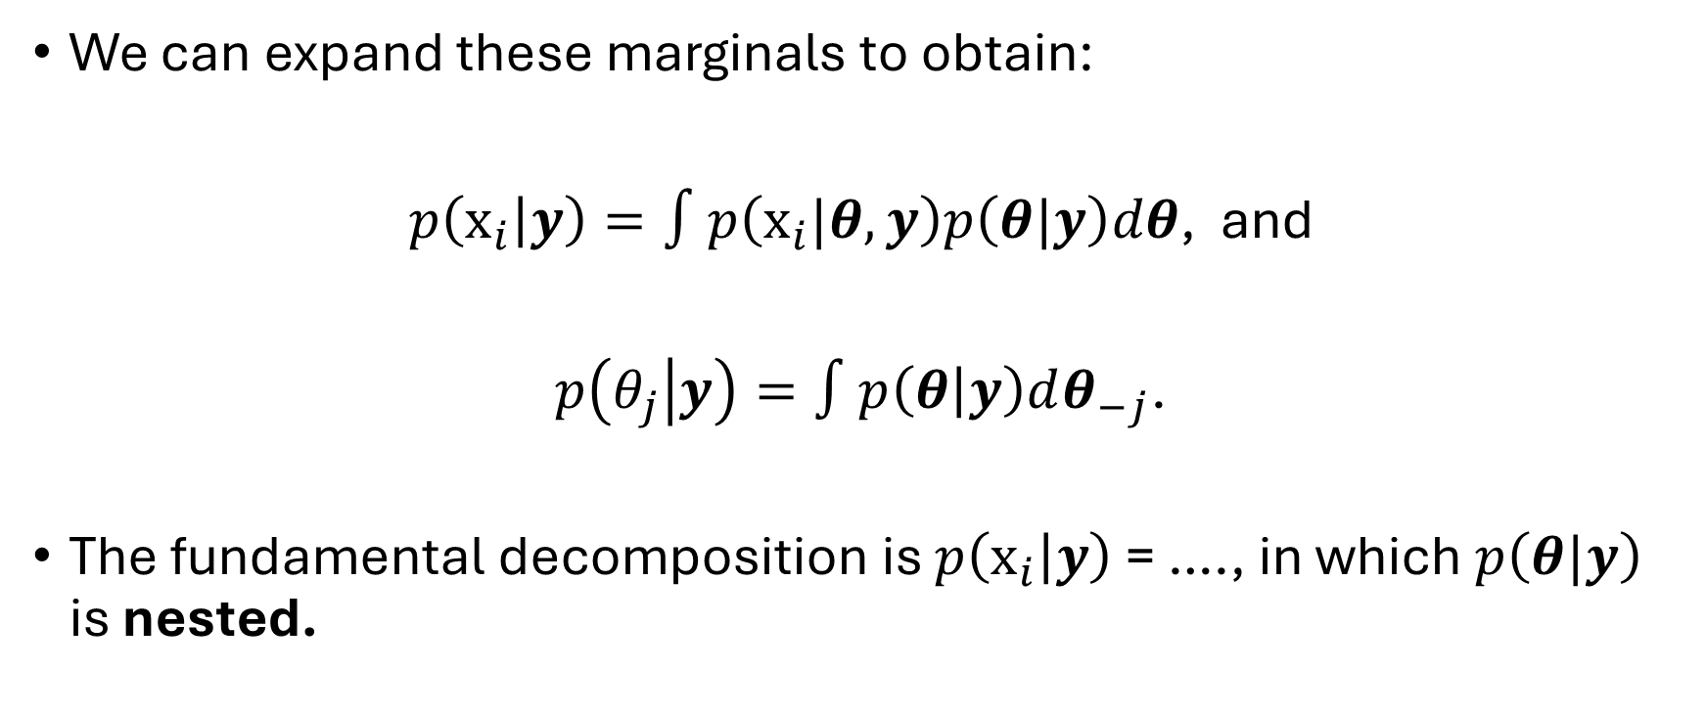
What does INLA actually calculate?
We can expand these marginals to obtain:
$p\left(x_{i} | y\right)=∫p\left(x_{i}|θ,y\right)p\left(θ|y\right)dθ$, and
$p\left(θ_{j} | y\right)=∫p\left(θ | y\right)dθ_{−j}$.
The fundamental decomposition is $p\left(x_{i} | y\right)$ = …., in which $p\left(θ|y\right)$ is nested.
The term “nested” comes from INLA approximating $p\left(θ|y\right)$. Then, conditional on particular values of $θ$, it approximates $p\left(x | y\right)$, and integrates over $θ$ to obtain $p\left(x_{i} | y\right)$.

Slide 39
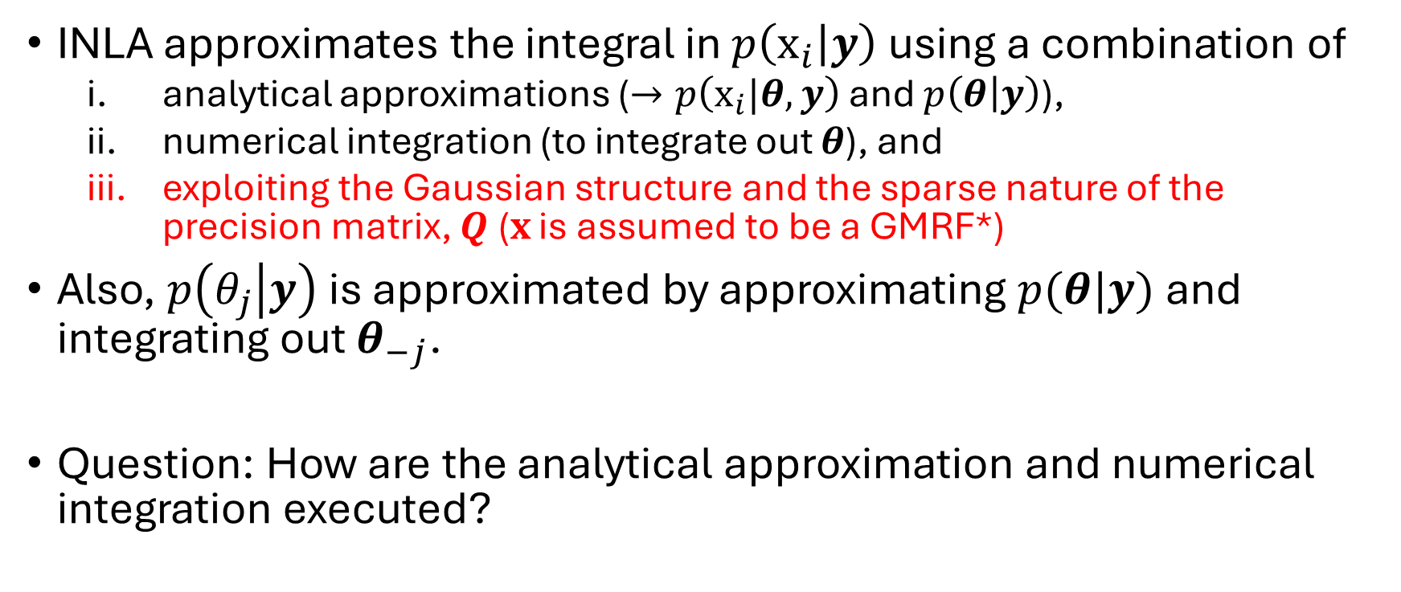
What does INLA actually calculate?
INLA approximates the integral in $p\left(x_{i} | y\right)$ using a combination of
  analytical approximations ($→p\left(x_{i}|θ,y\right)$ and $p\left(θ | y\right)$),
  numerical integration (to integrate out $θ$), and
  exploiting the Gaussian structure and the sparse nature of the precision matrix, $Q$ ($x$ is assumed to be a GMRF*)
Also, $p\left(θ_{j} | y\right)$ is approximated by approximating $p(θ|y)$ and integrating out $θ_{−j}$.
Question: How are the analytical approximation and numerical integration executed?
*Gaussian Markov Random Fields (GMRFs) are conditionally independent and have sparse precision matrices (containing some zero entries). This helps to speed up computation.

Slide 40
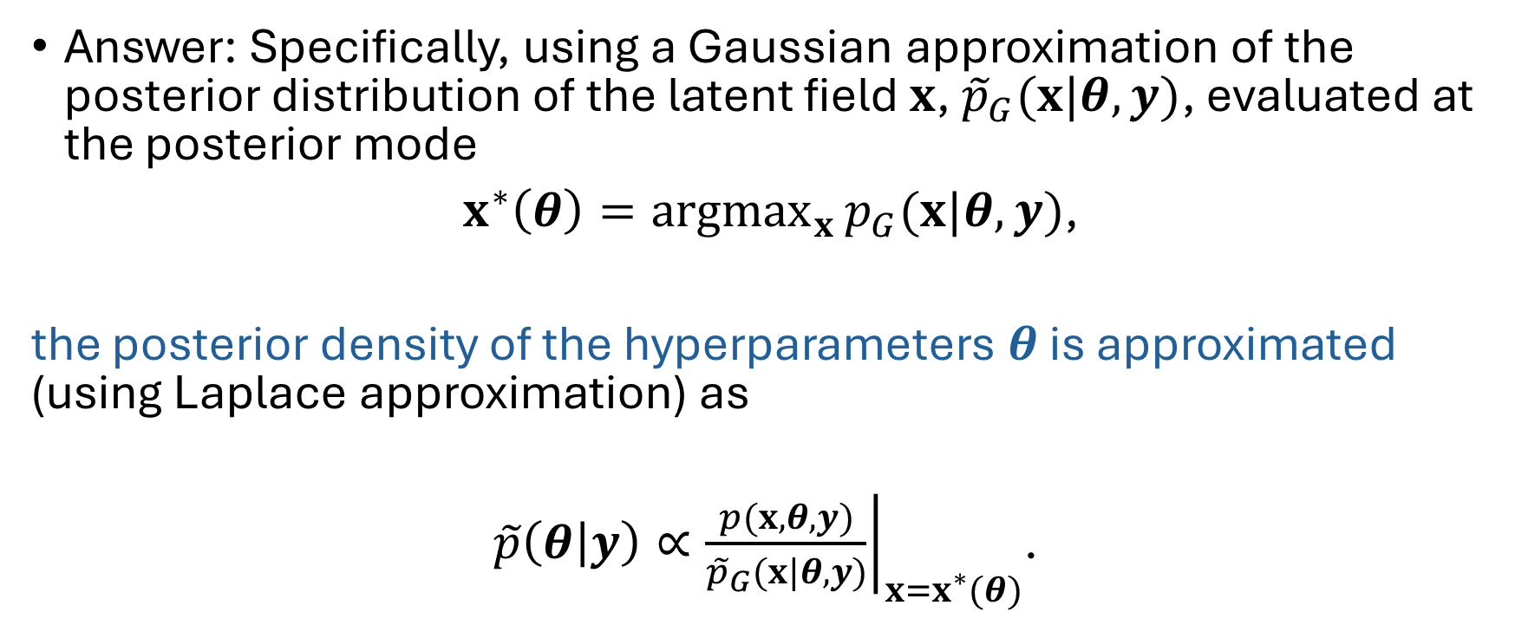
What does INLA calculate?
Answer: Specifically, using a Gaussian approximation of the posterior distribution of the latent field $x$, ${\tilde{p}}_{G}(x|θ,y)$, evaluated at the posterior mode
$x^{∗}\left(θ\right)={argmax}_{x}{p_{G}(x|θ,y)}$,
the posterior density of the hyperparameters $θ$ is approximated (using Laplace approximation) as
$\tilde{p}\left(θ | y\right)∝{\left.\frac{p(x,θ,y)}{{\tilde{p}}_{G}(x|θ,y)}\right|}_{x=x^{∗}(θ)}$.
NB: $p\left(θ | y\right)=\frac{p(x,θ|y)}{p(x|θ,y)}∝\frac{p(x,θ,y)}{p(x|θ,y)}$. You can use Bayes’ rule to solve this.
Note on Laplace approximation…..

Slide 41
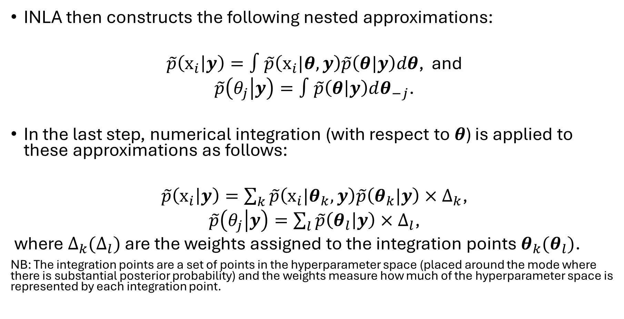
What does INLA actually calculate?
INLA then constructs the following nested approximations:
$\tilde{p}\left(x_{i} | y\right)=∫\tilde{p}\left(x_{i}|θ,y\right)\tilde{p}\left(θ|y\right)dθ$, and
$\tilde{p}\left(θ_{j} | y\right)=∫\tilde{p}\left(θ | y\right)dθ_{−j}$.
In the last step, numerical integration (with respect to $θ$) is applied to these approximations as follows:
$\tilde{p}\left(x_{i} | y\right)=\sum_{k}{\tilde{p}\left(x_{i}|θ_{k},y\right)\tilde{p}\left(θ_{k}|y\right)}×∆_{k}$,
$\tilde{p}\left(θ_{j} | y\right)=\sum_{l}{\tilde{p}\left(θ_{l} | y\right)}×∆_{l}$,
where $∆_{k}(∆_{l})$ are the weights assigned to the integration points $θ_{k}(θ_{l})$.
NB: The integration points are a set of points in the hyperparameter space (placed around the mode where there is substantial posterior probability) and the weights measure how much of the hyperparameter space is represented by each integration point.
Notes:
Relevant reference here is: https://share.google/Nxsr4Nh7eaB8ZJmlH A tutorial in spatial and spatio-temporal models with R-INLA

Slide 42
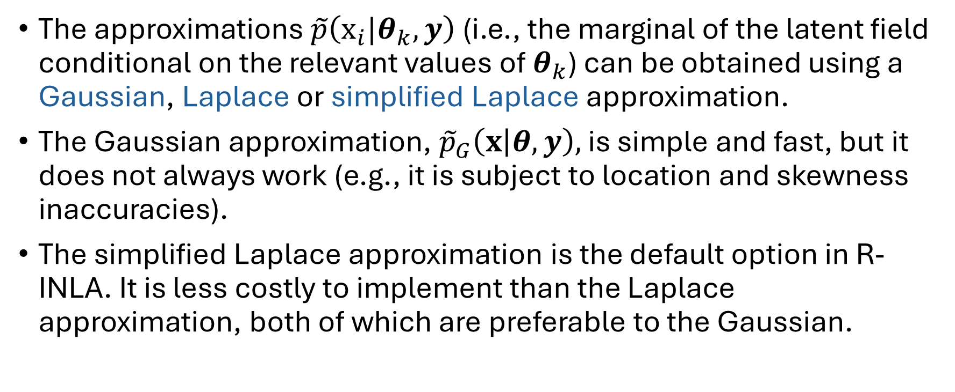
What does INLA actually calculate?
The approximations $\tilde{p}\left(x_{i}|θ_{k},y\right)$ (i.e., the marginal of the latent field conditional on the relevant values of $θ_{k}$) can be obtained using a Gaussian, Laplace or simplified Laplace approximation.
The Gaussian approximation, ${\tilde{p}}_{G}\left(x | θ,y\right),$ is simple and fast, but it does not always work (e.g., it is subject to location and skewness inaccuracies).
The simplified Laplace approximation is the default option in R-INLA. It is less costly to implement than the Laplace approximation, both of which are preferable to the Gaussian.

Slide 43
What does INLA actually calculate?
For a worked example with analytical forms for some of the posteriors involved in the approximation, see Section 4.9 (p. 118) of Blangiardo and Cameletti (2015). This example includes a comparison of the step-by-step approach with an R-INLA output.

Slide 44
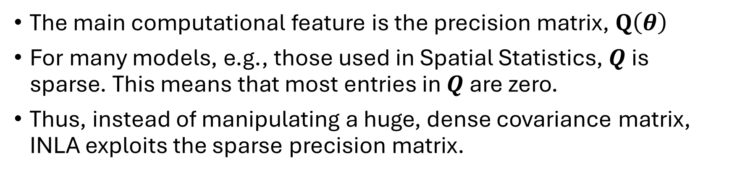
Why INLA works for LGMs
The main computational feature is the precision matrix, $Q\left(θ\right)$
For many models, e.g., those used in Spatial Statistics, $Q$ is sparse. This means that most entries in $Q$ are zero.
Thus, instead of manipulating a huge, dense covariance matrix, INLA exploits the sparse precision matrix.

Slide 45
INLA and inlabru packages: An example using linear regression analysis
formula <- pm10 ~ 1 + temperature
mod.inla <- inla(formula,
family = "gaussian",
data = mydata)
summary(mod.inla)
Interesting fact:
inlabru has a predict() function, making prediction post model-fitting easier!
One R formula holds the full linear predictor
inla() takes formula + family + data directly
'1' is the intercept; covariates added with '+'
cmp <- ~ Intercept(1) + temperature
likelihood <- bru_obs(
formula = pm10 ~ .,
family = "gaussian",
data = mydata)
mod.bru <- bru(cmp, likelihood)
summary(mod.bru)
Model specification/linear predictor split into components (cmp) + likelihood
Each term is named - here Intercept and temperature
likelihood's formula maps components onto the response
bru() combines components + likelihood to fit
To learn more about INLA and inlabru syntaxes, please visit: https://www.r-inla.org/ and https://inlabru-org.github.io/inlabru/index.html; https://inlabru-org.github.io/inlabruCourseMay2025/index.html

Slide 46
Exercise 2: Linear regression modelling in INLA/inlabru
For this exercise, we will use the data and R script contained in the folder “NMMAPS_data_and_code”.
The data “NMMAPSraw.csv”* contains daily pollutant and temperature concentrations for Salt Lake City (US) from 1987-2000.
The purpose of this exercise is to acquaint you with using INLA and inlabru for Bayesian analysis. The analysis is very basic as it does not account for some features in the data (e.g., temporal autocorrelation)
Follow the instructions contained in the script “Bayesian_linear_reg_example.R” to run it.
*The data were obtained from Blangiardo, M., & Cameletti, M. (2015). Spatial and spatio-temporal Bayesian models with R-INLA. John Wiley & Sons.

Slide 47
Relevant books
Spatial and Spatio‐temporal Bayesian Models with R‐INLA by Marta Blangiardo and Michela Cameletti
Geospatial Health Data: Modeling and Visualization with R-INLA and Shiny by Paula Moraga
Spatial Statistics for Data Science by Paula Moraga
Bayesian Modelling of Spatio-temporal Data with R by Sujit Sahu
Bayesian inference with INLA by Virgilio Gomez-Rubio
See https://www.r-inla.org/learnmore/books/index.html for more INLA books!

Slide 48
References
Blangiardo, M., & Cameletti, M. (2015). Spatial and spatio-temporal Bayesian models with R-INLA. John Wiley & Sons. https://doi.org/10.1002/9781118950203
Daniel Simpson, Håvard Rue, Andrea Riebler, Thiago G. Martins, Sigrunn H. Sørbye (2017). Penalising Model Component Complexity: A Principled, Practical Approach to Constructing Priors, Statist. Sci. 32(1), 1-28.
Gelman, Andrew, John B. Carlin, Hal S. Stern, David B. Dunson, Aki Vehtari, and Donald B. Rubin. 2013. Bayesian Data Analysis. 3rd ed. Boca Raton, FL: Chapman & Hall/CRC Press.
Rue, Havard, Sara Martino, and Nicolas Chopin. 2009. “Approximate Bayesian Inference for Latent Gaussian Models by Using Integrated Nested Laplace Approximations.” Journal of the Royal Statistical Society, Series B 71 (2): 319–92.

